Slide 1
Lp theory for outer measures: Application to time-frequency analzysis
Christoph Thiele
Santander, September 2014

Slide 2
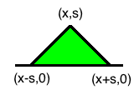
Recall Tents (or Carleson boxes)
X is the open upper half plane,
generating sets are tents T(x,s) :
Define outer measure on X by

Slide 3
Sizes
Sp average of function on a tent
Also Sinfty

Slide 4
Outer essential supremum
Space of functions with finite out.ess.supremum
Outer essential supremum on a subset F:

Slide 5
Outer Lp spaces
Define super level measures
Define Lp norms
Also weak Lp (Lorentz space)

Slide 6
Embedding theorems
Thm: Define for fixed Schwartz function ϕ
Then we have:
If φ has integral zero:

Slide 7
Paraproduct estimates
For two phi-I with mean 0 and one with mean 1
Hoelder with two qi equal 2 and one equal infty

Slide 8
Lerner’s sparse operator estimates
For two phi-I with mean 1 and some G
Hoelder with two qi equal infty and one equal 1

Slide 9
Bilinear Hilbert transform
Consider vector
Define the trilinear form
The bilinear Hilbert transform is any of the pre-dual bilinear operators.
May assume beta nonzero. By scaling may assume it is unit length. By change of variables may assume it is perpendicular to (1,1,1).

Slide 10
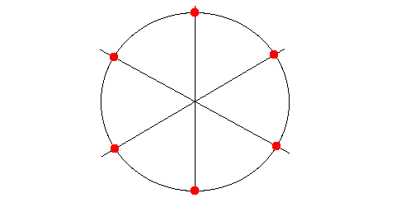
Degenerate case
If two beta-I are equal, degenerate case.
Reduce to pointwise product and Hilbert transf.
We consider only one fixed non-degenerate case

Slide 11
Boundedness of BHT
Theorem: Fix nondegenerate direction beta. Let
Then there is an a priori estimate
Extensions exist for p-I less than 2, but that is for some other time.

Slide 12
Symmetries
Like CZ operators, BHT is invariant under simultaneous translation of f-i and has proper scaling under simultaneous dilation of f-i.
It has additional one parameter modulation symm.
This equals original BHT if alpha perpendicular to beta and (1,1,1). BHT shares symmetries with

Slide 13
New embedding map
Additional symmetry makes the upper half plane embedding inappropriate and useless.
Need embedding map reflecting the orbit of entire symmetry group :
Phi assumed to have FT nonnegative and with small support near 0. The testing wavelets become arbitrarily high oscillating wavepacket.

Slide 14
BHT in terms of embedded fcts
(Remark: The RHS is the bilinear Cauchy projection.)
Two ways of proving this algebraic identity:
Exercise in applying Plancherel, akin to the proof of the Calderon reproducing formula.
Checking RHS satisfies the symmetries, and noting that any form with these symmetries is a linear combination as on LHS. Prove RHS not multiple of Lambda tilde to show a not 0.

Slide 15
Proof of symmetries
By change of variables.
Translation symmetry: y to y+y’
Modulation symmetry: eta to eta+eta’
Dilation symmetry: t to ts, y to ys, eta to eta/s

Slide 16
Not multiple of Lambda tilde
For fixed eta,y,t we have a pairing of with a certain nonnegative bump.
This bump is supported on the half space
If is supported outside this half space, then form vanishes. If supported and positive in half space, then form does not vanish.
So form not invariant under beta-modulation.

Slide 17
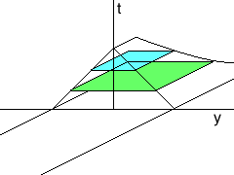
Define outer measure on upper 3space

Slide 18
Outer triangle inequality
where

Slide 19
Outer Hoelder inequality
Where we need to identify appropriate sizes
S1,S2,S3 which satisfy size-Hoelder

Slide 20
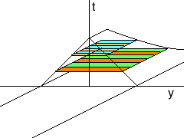
Idea of sizes
The j-size is a sum of L2 and Linfty average. The L2 is taken outside an exceptional region A-j. The three exceptional regions are disjoint.

Slide 21
Size-Hoelder
To prove
We split the integral over tent on LHS into four regions: three orange regions and the rest.
On each exceptional region we do the appropriate 2-2-infty Hoelder, since we control two functions in L2. On the rest, either of the Hoelders is OK.

Slide 22
Modified outer measure space
To formulate sizes precisely, express everything for F rather than G (change variables). Fix j.
Tents:
Size (pick small parameter b): Note: regions A
Will be disjoint for different j after change vrbls.

Slide 23
Main embedding theorem
After this preparation, bounds for BHT are reduced to embedding theorem
For 2<p<infty

Slide 24
Few comments on the proof
Story told by pictures…

